Slide 1
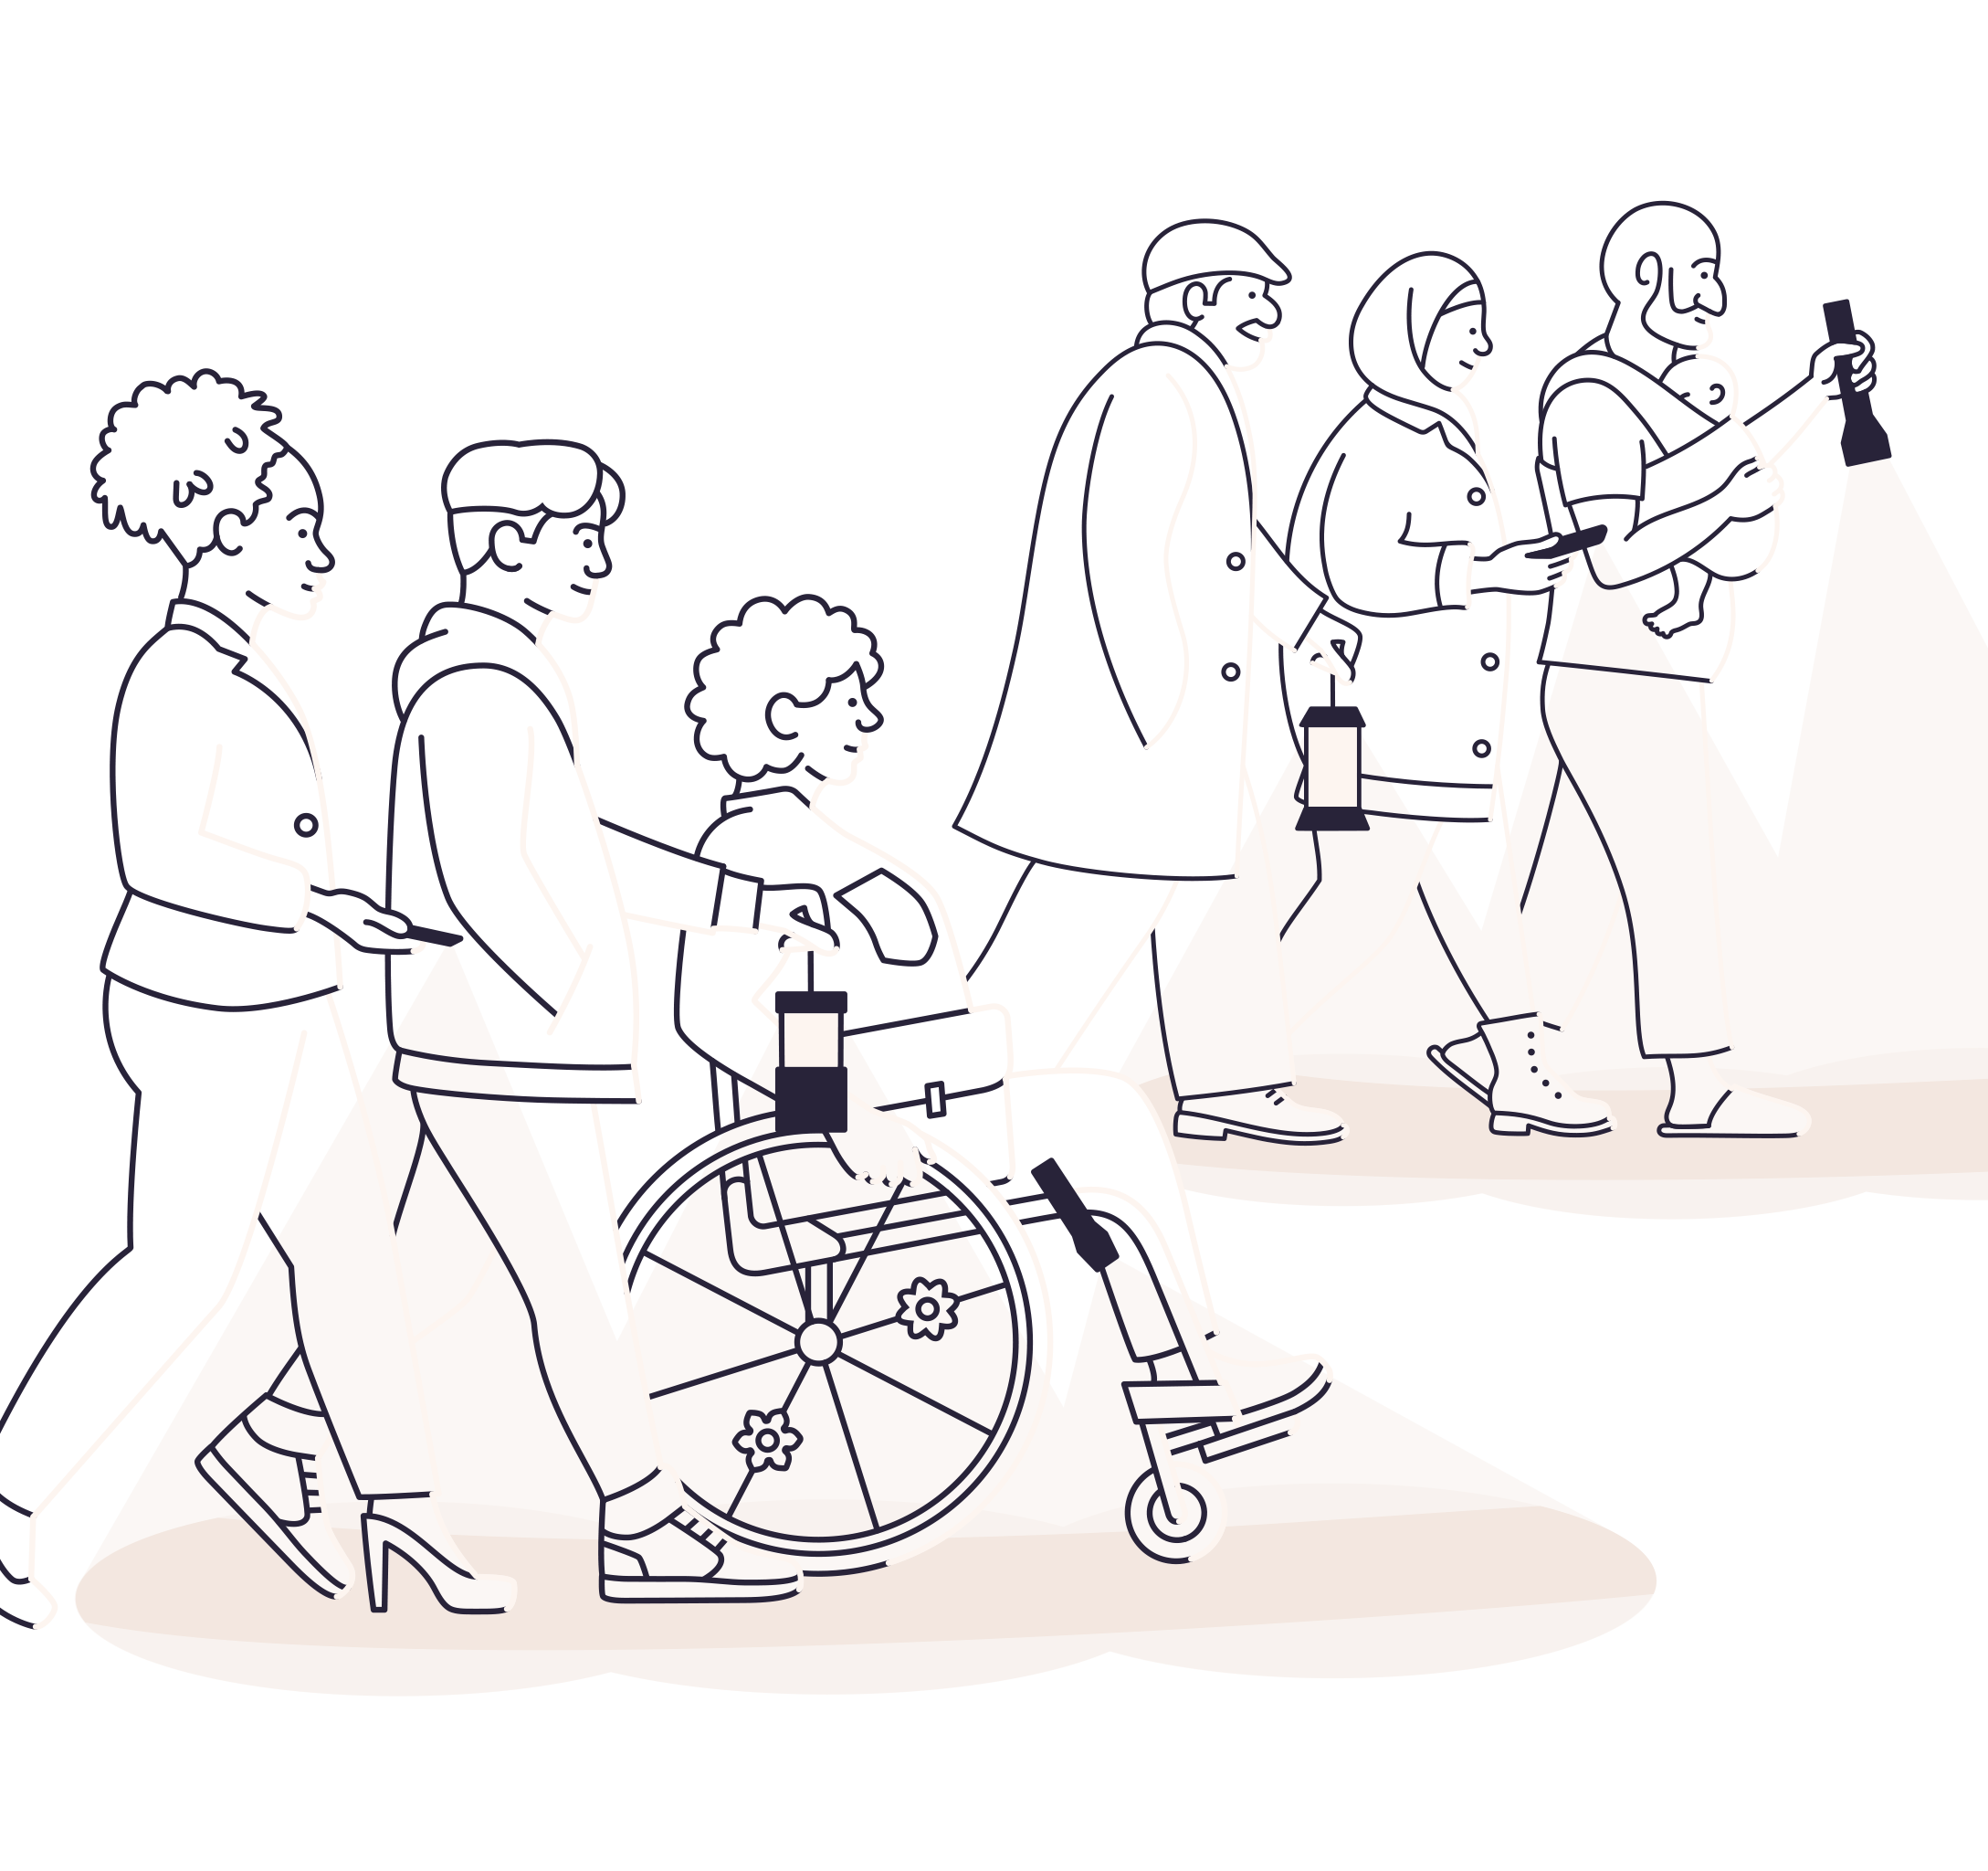
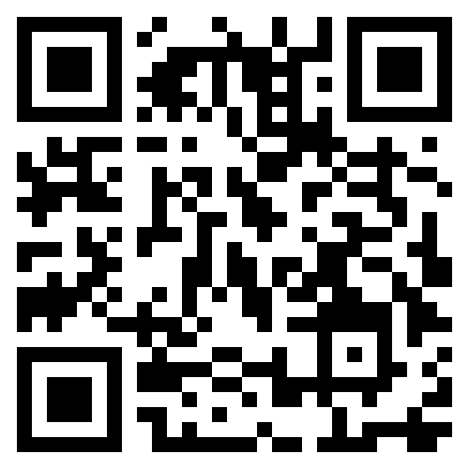
An online clinical trial of brain training in people with long COVID
To be eligible you must:
Be aged 18 or over
Have experienced brain fog or memory problems since having COVID-19
Have access to a computer and the internet
Live in the UK
Speak English
An online clinical trial of brain training in people with long COVID
To be eligible you must:
Be aged 18 or over
Have experienced brain fog or memory problems since having COVID-19
Have access to a computer and the internet
Live in the UK
Speak English
Join us today: beaconstudy.org.uk
SCAN ME!!
IRAS Number: 327021 BEACON Trial Primary Care Advert v1.0; dated 5 June 2023

